Slide 1
OPTICAL CHARACTER RECOGNITION(OCR)
BY EC39
UTSAV MUNGRA

Slide 2
CONTENTS:
Definition
Introduction To OCR
Problem Overview
Uses
Types
Steps in OCR
Accuracy
Software Implementation
Pros and Cons
Research

Slide 3
DEFINITION
Optical Character Recognition (OCR) is the mechanical or electronic conversion of images of typewritten or printed text into machine-encoded text.

Slide 4
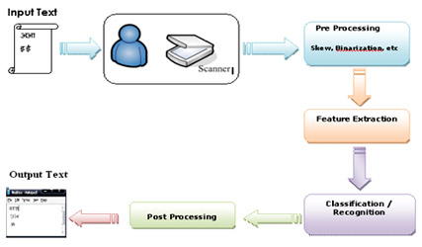

Slide 5
PROBLEM OVERVIEW
Humans are bound to make errors - some time or the other - especially while performing mundane boring tasks like digitization or Security, continuously..
Many times we are unable to perceive certain digits due to various factors- motion, lack digit clarity, illumination and so on.
It is these problems which have lead us to delve into this topic.

Slide 6
USES
It is widely used as a form of Data Entry from Printed Paper data records, whether Passport Documents, Invoices, Bank Statements, Business Card, Mail or Other Documents.
It is common method of Digitizing Printed Texts so that it can be Electronically edited, searched, stored more compactly, displayed online, and used in Machine Processes such as Machine Translation, Text-to-Speech, Key Data and Text Mining.

Slide 7
TYPES:
1)Optical Character Recognition (OCR )
Targets typewritten text, one Glyph or Character at a time.
2)Optical Word Recognition (OWR )
Targets typewritten text, one word at a time (for languages that use a space as a word divider).
3)Intelligent Character Recognition ( ICR)
Targets handwritten print script or cursive text one glyph or character at a time, usually involving
4) Intelligent Word Recognition (WR)
Targets handwritten print script or cursive text, one word at a time. This is especially useful for languages where glyphs are not separated in cursive script.

Slide 8
Pre-Processing
Deals with Improving quality of the Image for better recognition by the system. OCR software often "pre-processes" images to improve the chances of successful recognition
Techniques include:
De-Skew
Despeckle
Binarization
Line Removal
Zoning
Line and Word DetectionScript

Slide 9
Character Recognition
There are two basic types of core OCR algorithm, which may produce a ranked list of candidate characters.
Matrix matching involves comparing an image to a stored glyph on a pixel-by-pixel basis; it is also known as "patternmatching“ .This relies on the input glyph being correctly isolated from the rest of the image, and on the stored glyph being in a similar font and at the same scale. This technique works best with typewritten text and does not work well when new fonts are encountered.
Feature extraction decomposes glyphs into "features" like lines, closed loops, line direction, and line intersections. Feature Extraction serves two purposes; one is to extract properties that can identify a character uniquely. Second is to extract properties that can differentiate between similar characters.

Slide 10
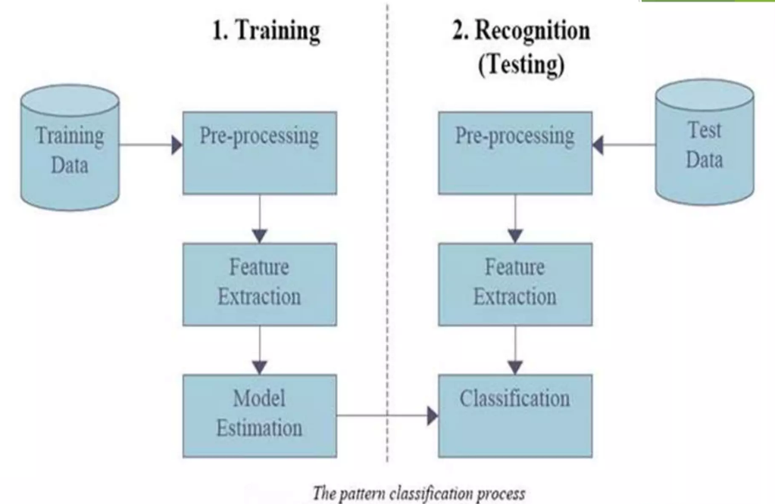

Slide 11
Post-processing
OCR accuracy can be increased if the output is constrained by a lexicon - a list of words that are allowed to occur in a document. This might be, for example, all the words in the English language, or a more technical lexicon for a specific field. This technique can be problematic if the document contains words not in the lexicon, like proper nouns. Tesseract uses its dictionary to influence the character segmentation step, for improved accuracy.

Slide 12
Accuracy
Recognition of Latin-script, typewritten text is still not 100% accurate even where clear imaging is available. One study based on recognition of 19th- and early 20th-century newspaper pages concluded that character. by-character OCR accuracy for commercial OCR software varied from 81% to 99%; total accuracy can be achieved by human review or Data Dictionary Authentication.
Other areas-including recognition of hand printing, cursive handwriting, and printed text in other scripts are still the subject of active research.

Slide 13
Accuracy
Accuracy rates can be measured in several ways, and how they are measured can greatly affect the reported accuracy rate.
For example, if word context (basically a lexicon of words) is not used to correct software finding nonexistent words, a character error rate of 1% (99% accuracy) may result in an error rate of 5% (95% accuracy) or worse if the measurement is based on whether each whole word was recognized with no incorrect letters

Slide 14
Pros and Cons
OCR reduces time for processing for processing data from large number of forms.
If done manually, may lead to human error and takes up much of the time.
Recognition of cursive text is an active area of research, with recognition rates even lower than that of hand-printed text.
Higher rates of recognition of general cursive script will likely not be possible without the use of contextual or grammatical information.

Slide 15
Conclusion
OCR technology provides fast, automated data capture which can save considerable time and labour costs of organisations.
The system has its advantages such as Automation of mundane tasks, Less Time Complexity, Very Small Database and High Adaptability to untrained inputs with only a small number of features to calculate.

